Slide 1

Continuation of Optimization: Momentum, RMSProp and Adam

Slide 2
Gradient Descent - recap
Gradient descent is a way to minimize an objective function J(θ) parameterized by a model's parameters θ∈Rd by updating the parameters in the opposite direction of the gradient of the objective function ∇θJ(θ) w.r.t. to the parameters.
The learning rate η determines the size of the steps we take to reach a (local) minimum.
In other words, we follow the direction of the slope of the surface created by the objective function downhill until we reach a valley.

Slide 3
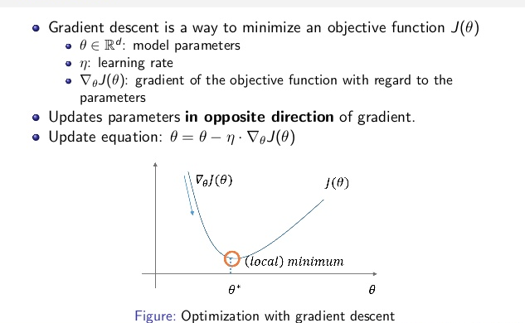
Gradient Descent - recap

Slide 4
The choice of optimization algorithm for your deep learning model can mean the difference between good results in minutes, hours, and days.

Slide 5
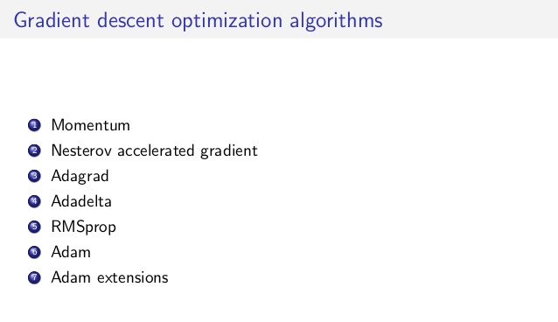

Slide 6
Momentum
Momentum methods in the context of machine learning refer to a group of tricks and techniques designed to dampen oscillations and speed up convergence of first order optimization methods like gradient descent (and its many variants).
They essentially work by adding what’s called the momentum term to the update formula for gradient descent, thereby improve its natural “zigzagging behavior,” especially in long narrow valleys of the cost function.

Slide 7
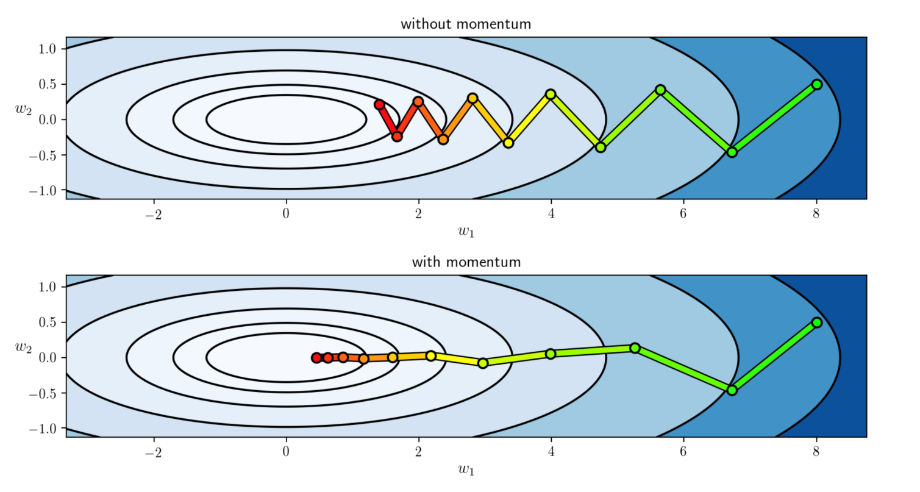
Momentum
The figure below shows the progress of gradient descent - with and without momentum - towards reaching the minimum of a cost function, located at the center of the concentric elliptical contours.

Slide 8
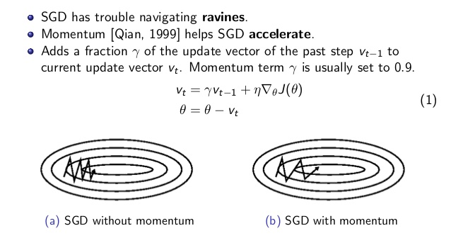
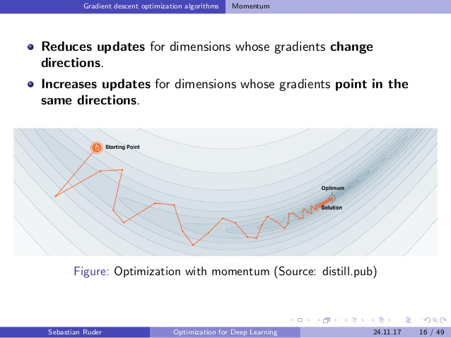
Instead of using only the gradient of the current step to guide the search, momentum also accumulates the gradient of the past steps to determine the direction to go.
In practice, the momentum term is initialized at 0.5, and gradually annealed to 0.9 over multiple epochs.

Slide 9
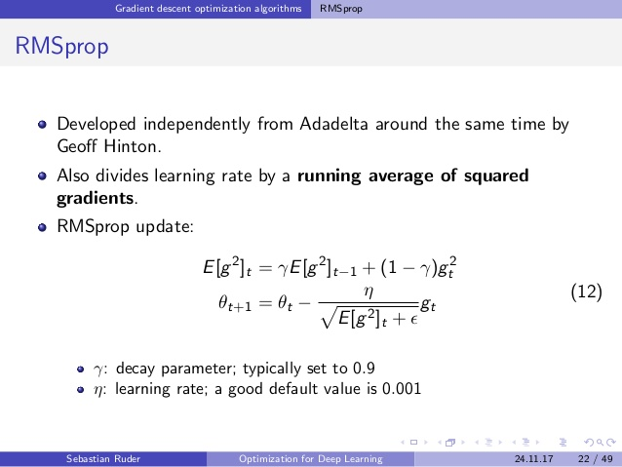
RMSProp
RMSprop, or Root Mean Square Propagation also tries to dampen the oscillations, but in a different way than momentum. RMS prop also takes away the need to adjust learning rate, and does it automatically. More so, RMSProp choses a different learning rate for each parameter.
E[g²]- moving average of squared gradients
g_{t} - gradient of cost function

Slide 10
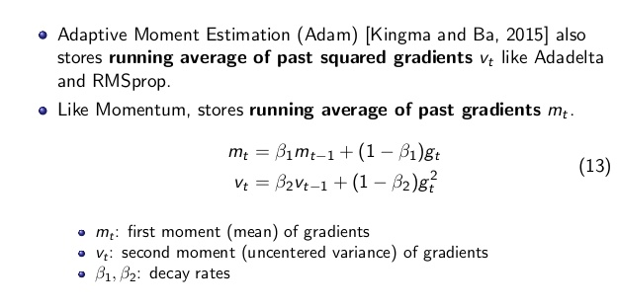
Adam
As mt and vt are initialized as vectors of 0's, the authors of Adam observe that they are biased towards zero, especially during the initial time steps, and especially when the decay rates are small (i.e. β1 and β2 are close to 1).
Default value of 0.9 for β1, 0.999 for β2, and 10E−8 for ϵ.

Slide 11
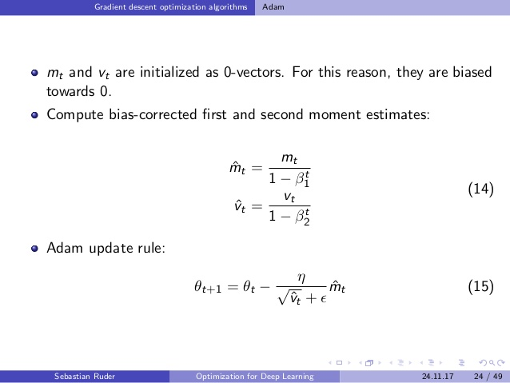

Slide 12
ADAM
In addition to storing an exponentially decaying average of past squared gradients vt like Adadelta and RMSprop, Adam also keeps an exponentially decaying average of past gradients mt, similar to momentum.
Whereas momentum can be seen as a ball running down a slope, Adam behaves like a heavy ball with friction, which thus prefers flat minima in the error surface
The Adam optimization algorithm is an extension to stochastic gradient descent that has recently seen broader adoption for deep learning applications in computer vision and natural language processing.

Slide 13
Adam combines the advantages of two other extensions of stochastic gradient descent. Specifically:
Adaptive Gradient Algorithm (AdaGrad) that maintains a per-parameter learning rate that improves performance on problems with sparse gradients (e.g. natural language and computer vision problems).
Root Mean Square Propagation (RMSProp) that also maintains per-parameter learning rates that are adapted based on the average of recent magnitudes of the gradients for the weight (e.g. how quickly it is changing). This means the algorithm does well on online and non-stationary problems (e.g. noisy).

Slide 14
Advantages of ADAM
Adam is a popular algorithm in the field of deep learning because it achieves good results fast.
Using large models and datasets, we demonstrate Adam can efficiently solve practical deep learning problems.
In practice Adam is currently recommended as the default algorithm to use, and often works slightly better than RMSProp.
However, it is often also worth trying SGD+Nesterov Momentum as an alternative.

Slide 15
ADAM benefits
attractive benefits of using Adam on non-convex optimization problems, as follows:
Straightforward to implement.
Computationally efficient.
Little memory requirements.
Well suited for problems that are large in terms of data and/or parameters.
Appropriate for problems with very noisy/or sparse gradients.
Hyper-parameters have intuitive interpretation and typically require little tuning.

Slide 16
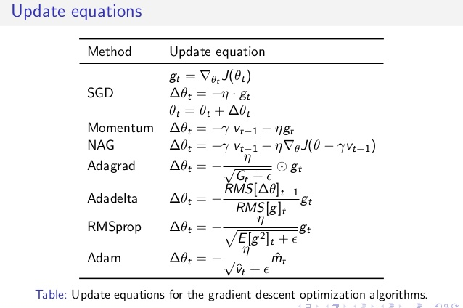

Slide 18
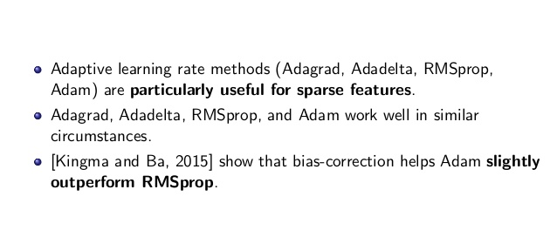
Which optimizer to choose?

Slide 19
Source
https://machinelearningmastery.com/adam-optimization-algorithm-for-deep-learning/#:~:text=The%20authors%20describe%20Adam%20as,language%20and%20computer%20vision%20problems).
http://ruder.io/optimizing-gradient-descent/index.html#rmsprop
https://medium.com/paperspace/intro-to-optimization-in-deep-learning-momentum-rmsprop-and-adam-8335f15fdee2
http://ruder.io/optimizing-gradient-descent/

